Slide 1
In the name of God
General Theory of electrical machines
Machine modeling such as motors, generators, transformers
Dynamic analysis of electrical machines including saturation
Simulation , numerical analysis

Slide 2
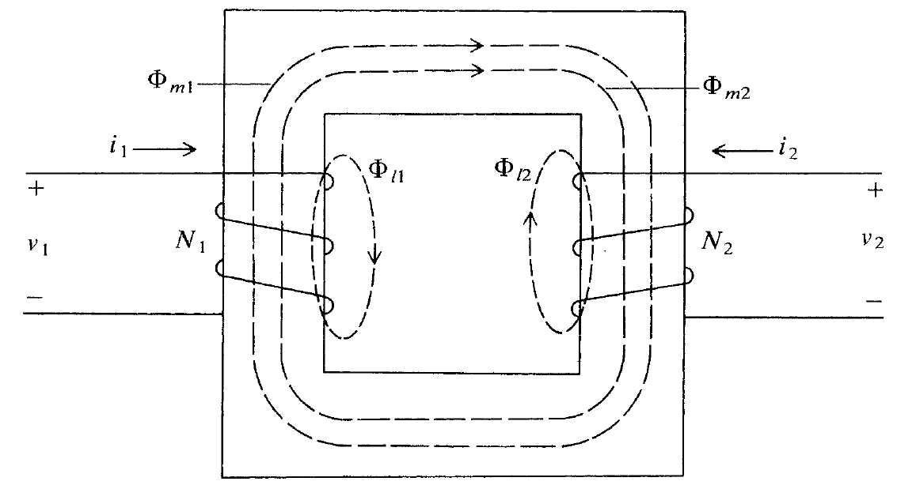
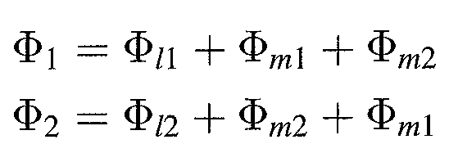
Chapter 1 BASIC PRINCIPLES FOR ELECTRICAL MACHINE ANALYSIS
MAGNETIC COUPLED CIRCUITS

Slide 3
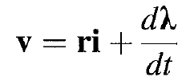
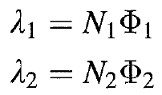
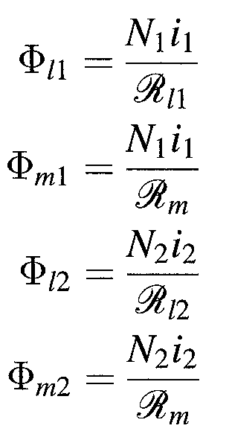
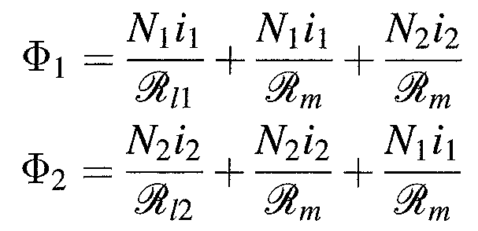
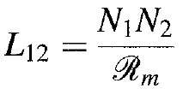
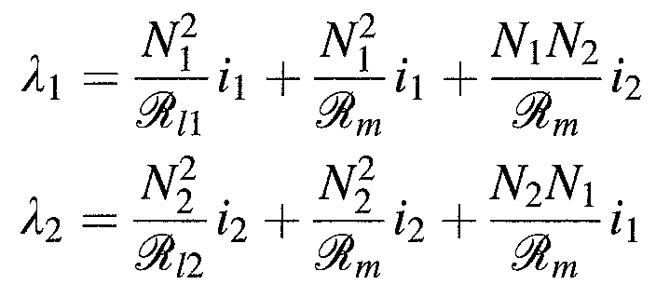
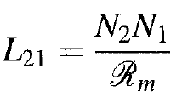

Slide 4
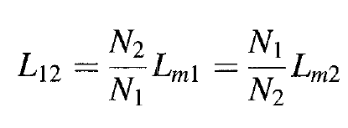
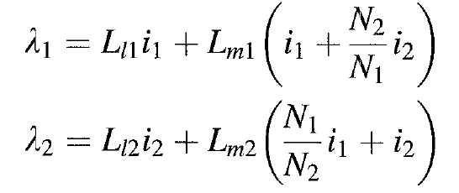
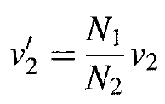
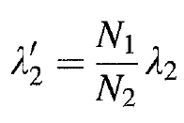

Slide 5
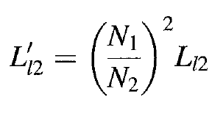
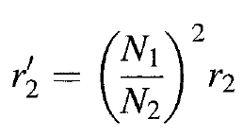
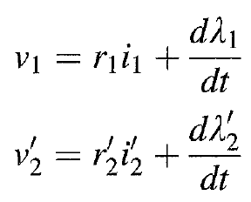
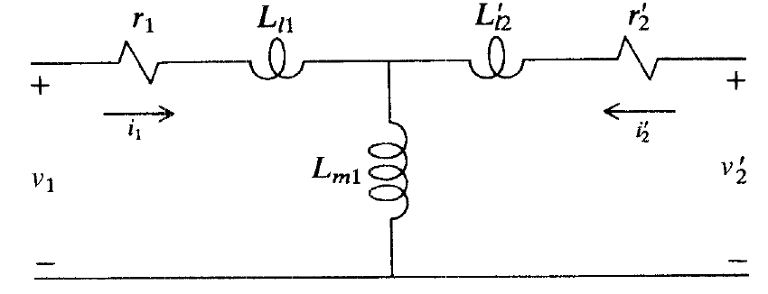

Slide 6
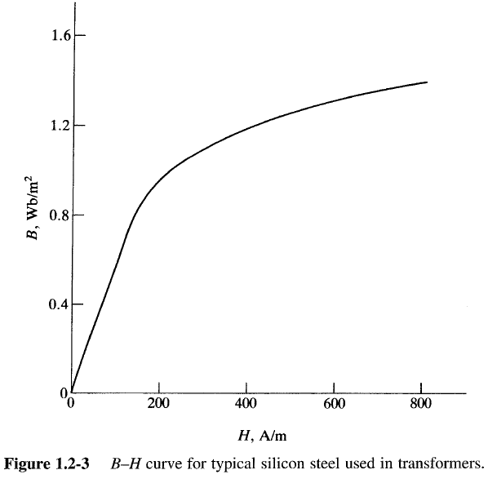
Nonlinear Magnetic System

Slide 7
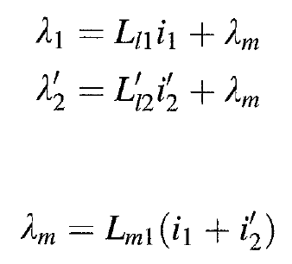
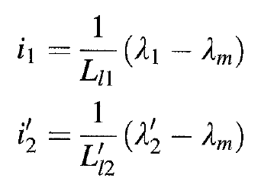
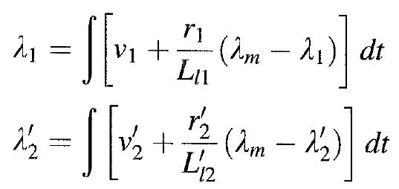
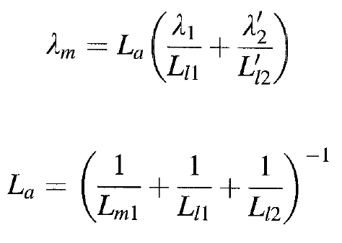

Slide 8
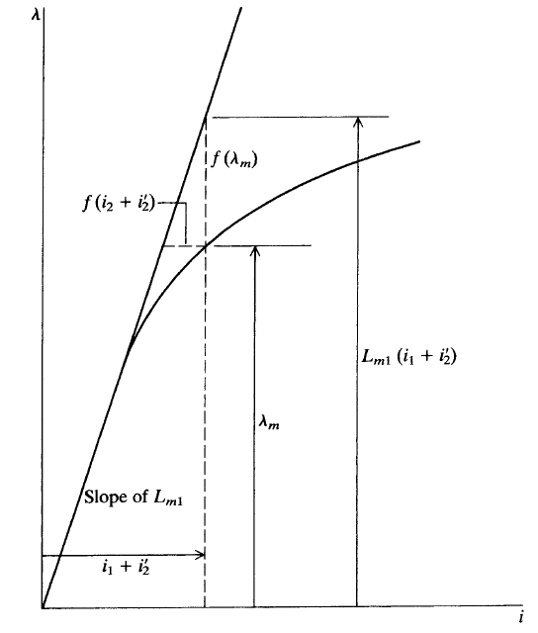
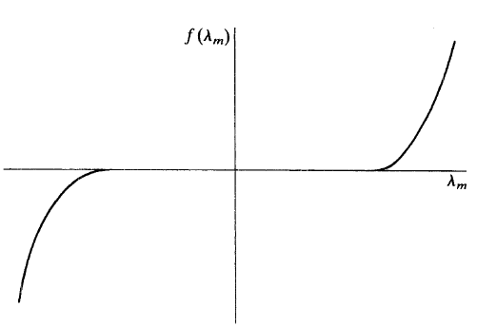

Slide 9
Chapter 2 Electromechnical Energy Conversion

Slide 10
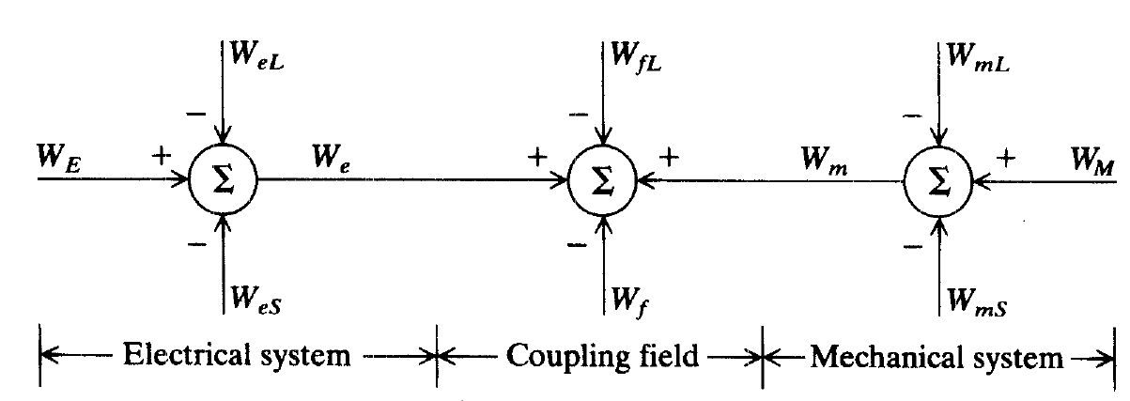
Energy transfered to the coupled field
Enegry Losses
Energy stored on magnetic or electric field
Total Enegry Transfered to the cuopling fields

Slide 11
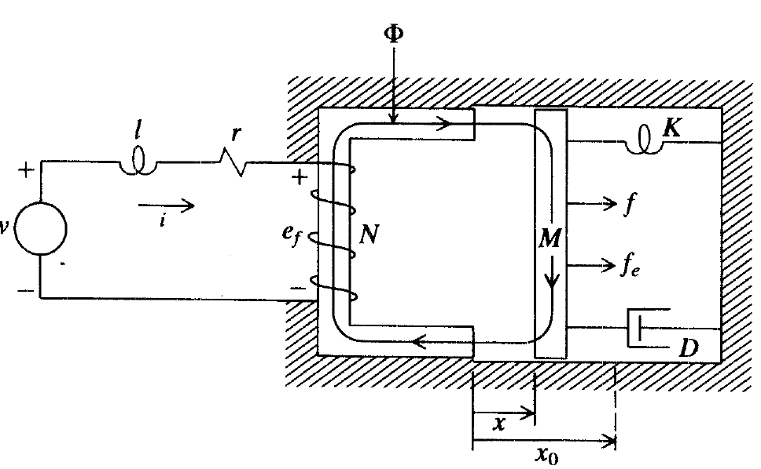
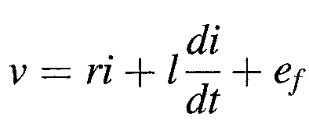
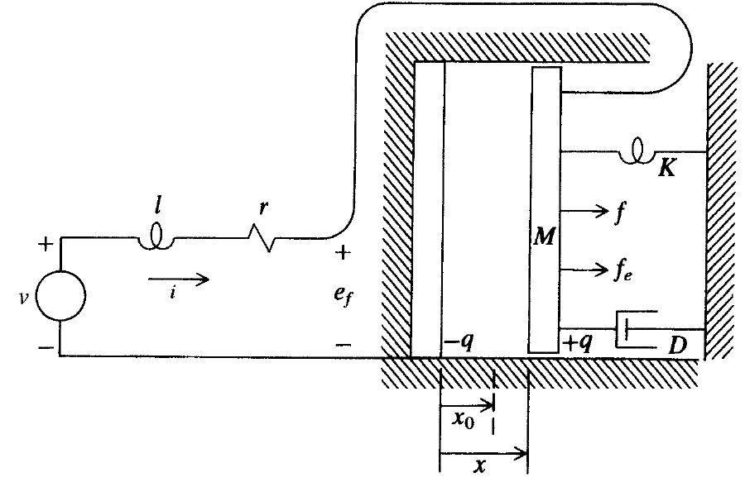

Slide 12
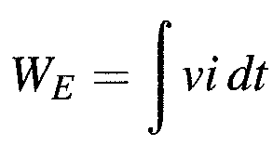
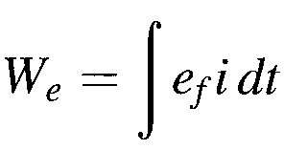
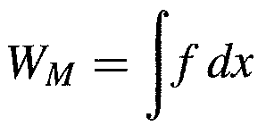
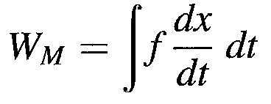
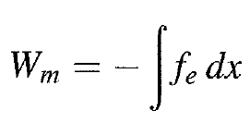
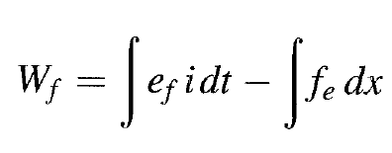

Slide 13
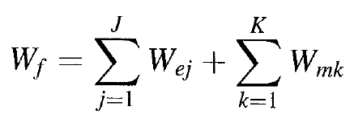
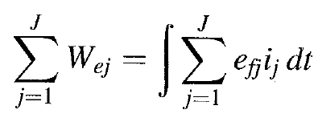
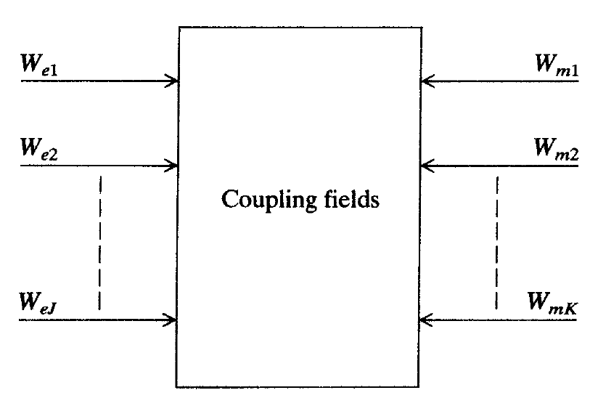

Slide 15
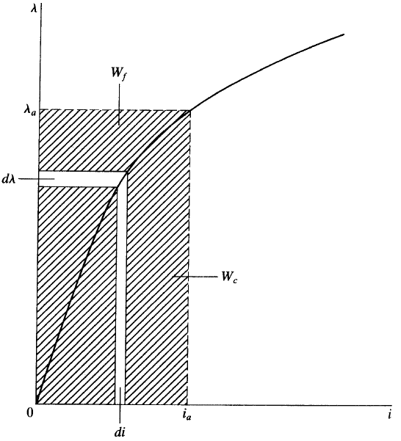
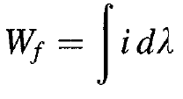
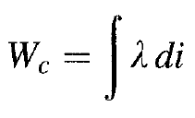
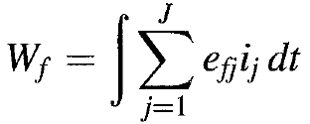
Energy in coupling field

Slide 16
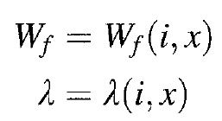
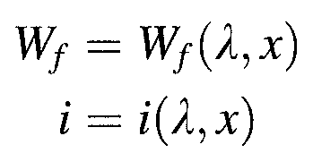

Slide 17
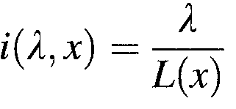

Slide 18
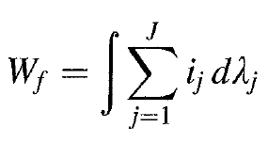

Slide 21
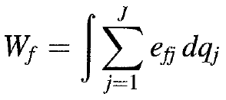
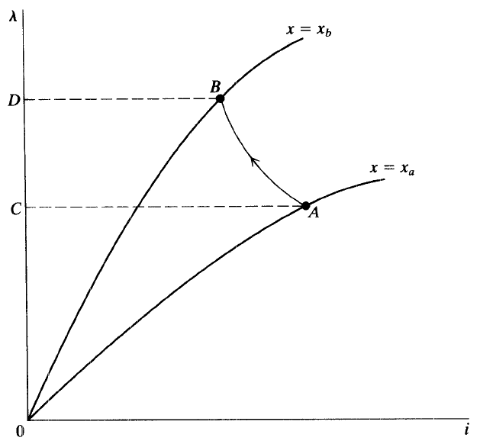

Slide 22
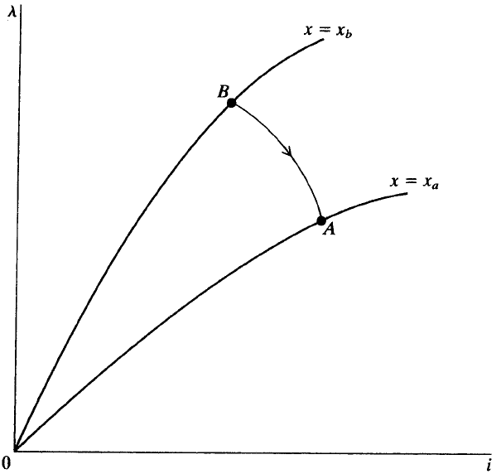
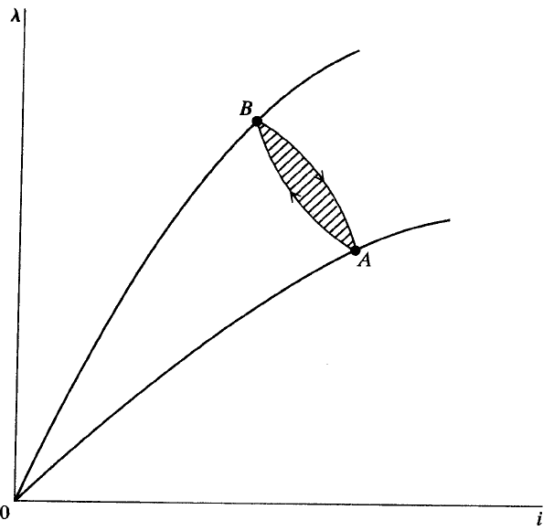

Slide 23
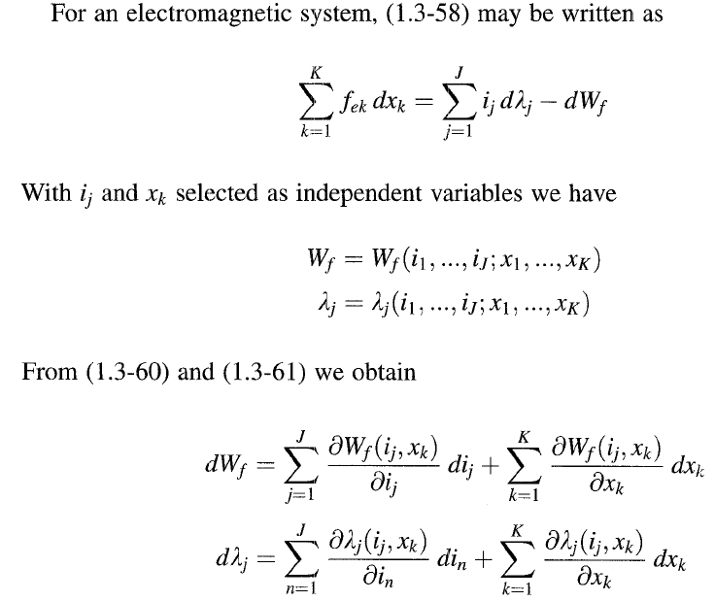
Electromagnetic and Electrostatic Forces

Slide 28
Steady-state and Dynamic Performance of an Electromechanical System

Slide 31
Machine Windings and Air Gap MMF

Slide 38
Synchronous Machines

Slide 42
Induction Machines

Slide 44
Chapter 3 Direct Current Machines

Slide 48
Voltage and Torque equations

Slide 49
Seperate Winding excitation

Slide 50
Shunt connected DC machine

Slide 52
Series connected DC machine

Slide 53
Compound-connected DC machine

Slide 55
Shunt connected DC machine

Slide 58
Permannet Magnet DC machine

Slide 59
Reference-Frame Theory
Background
Stator winding of synchronous machine variable Park 1920s
Rotor variables - induction machine variable Stanley 1930s
Rotor & stator variables - induction machine variable Korn 1940s
Reference frame theory is basically mathematical

Slide 62
Resistive Load
Inductive Load

Slide 64
Capacitive Load

Slide 67
Transformation between references

Slide 70
Synchronous Reference

Slide 73
Dynamic of RL series load
Zeroes initial condition

Slide 76
Symmetrical induction machines

Slide 79
Torque equation in machine variables

Slide 81
Rotor Circuit Transformation

Slide 82
Voltage equation in arbitraty refrences frame

Slide 86
Ψ=λω

Slide 90
Per Unit System

Slide 91
Inertia Constant

Slide 92
Phasor Analysis

Slide 96
Per Unit

Slide 97
Tmax

Slide 116
Three phase fault at terminals

Slide 119
Synchronous Generator

Slide 124
Torque Equation

Slide 140
Per Unit

Slide 141
Analysis of Steady State

Slide 143
Motor Action

Slide 146
At no load operation

Slide 148
Dynamic Performance

Slide 166
Hydro

Slide 167
Steam

Slide 173
Induction machine

