Slide 1
Power electronics I
Introduction
DC-DC converter
Discontinues Operation of DC-DC converter
DC switch mode power supply
Resonance inverters
Harmonic analysis
Final Exam
Class activity
Paper Simulation

Slide 2
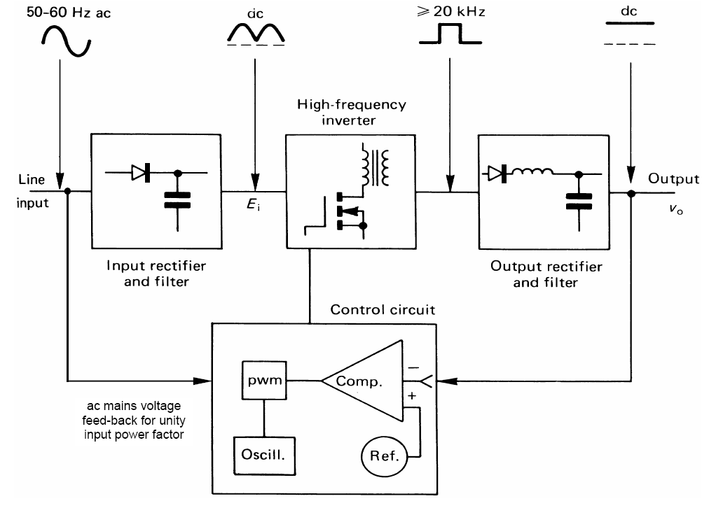
Introduction

Slide 3
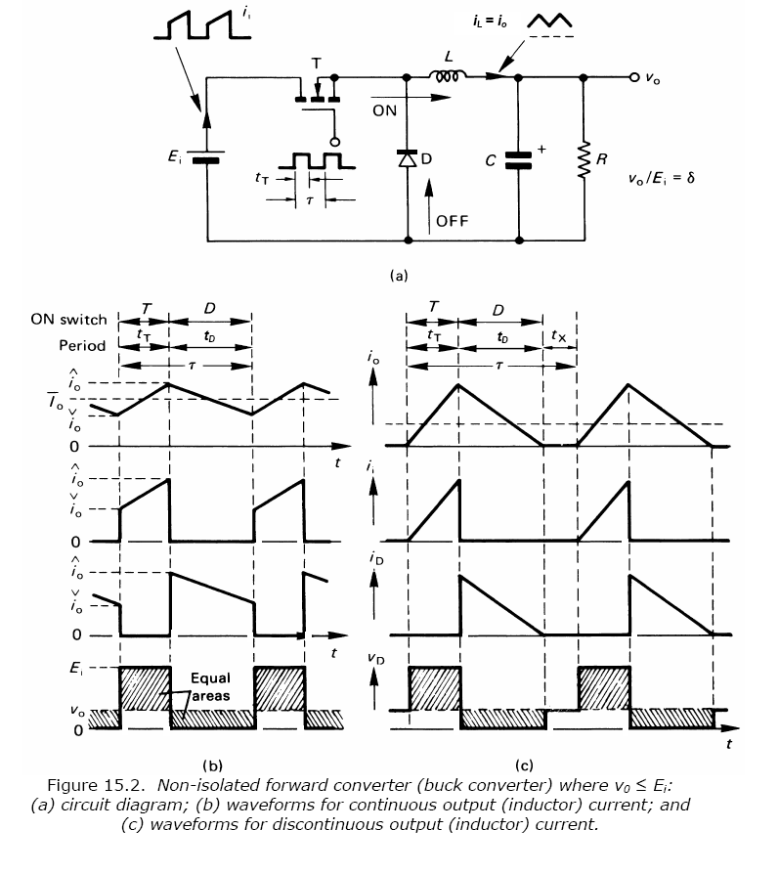
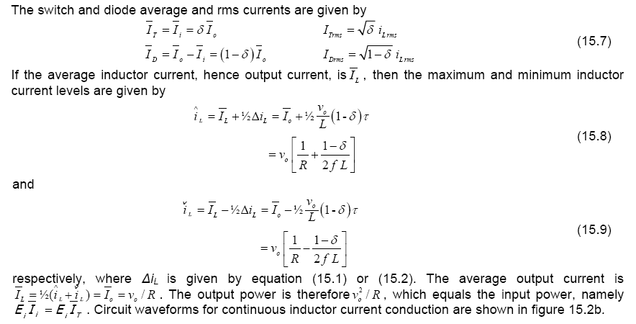
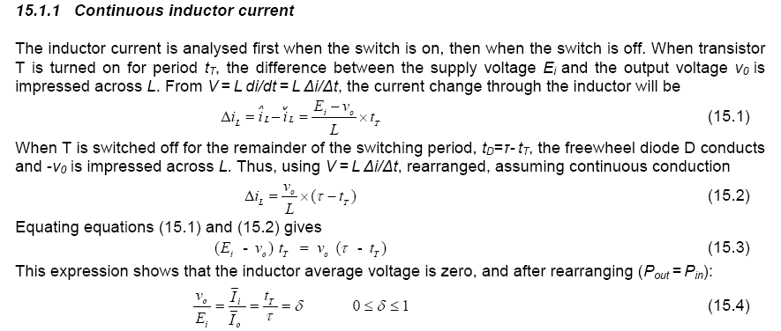
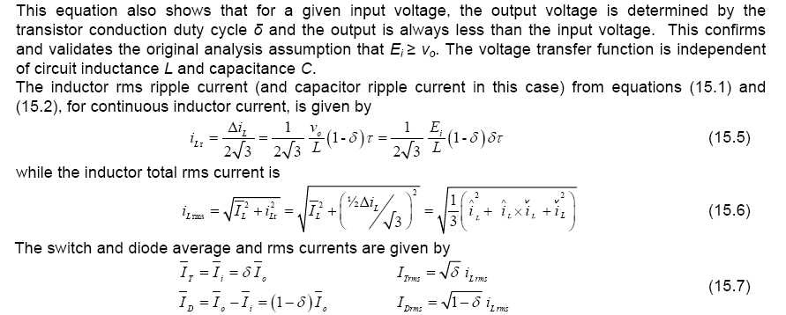

Slide 4
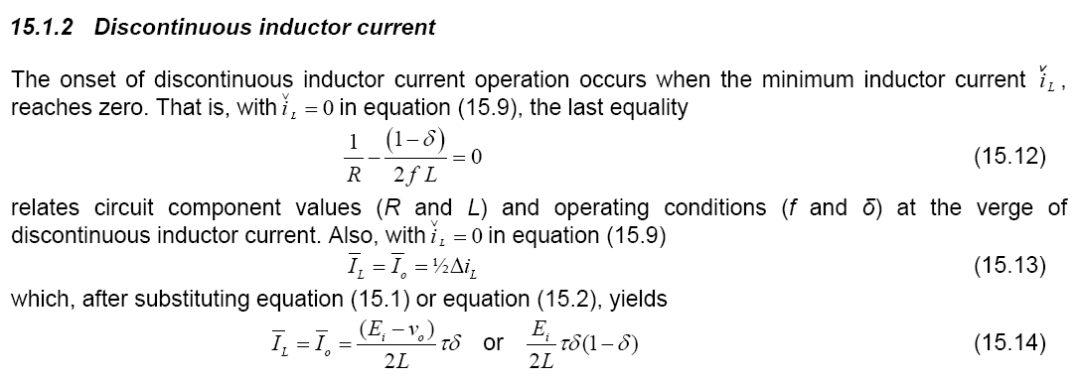

Slide 7
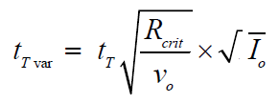

Slide 8
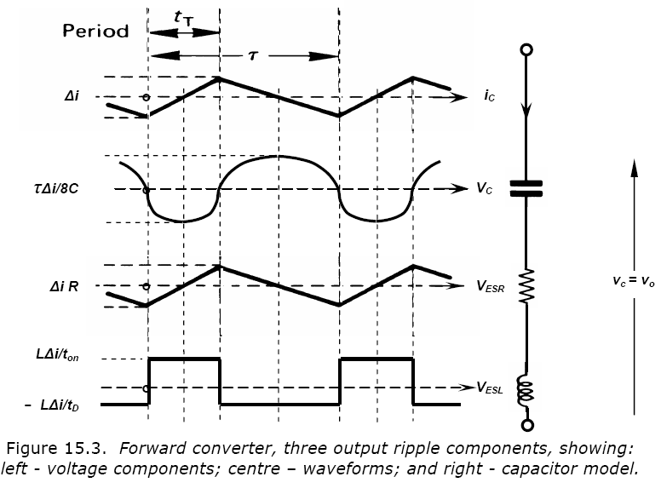
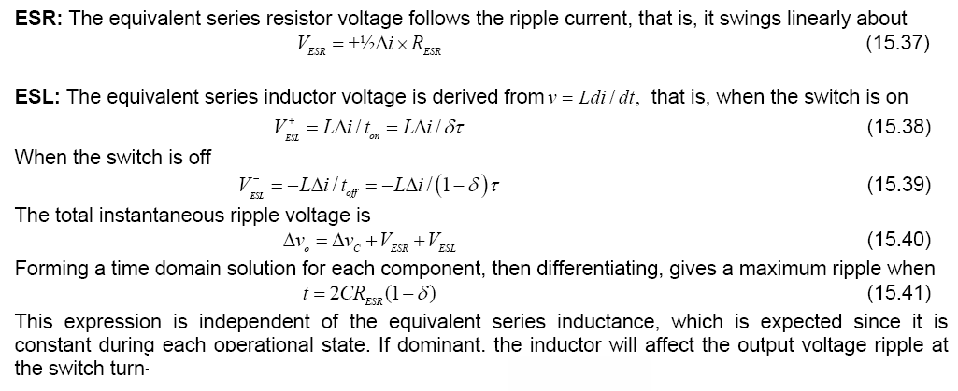

Slide 9
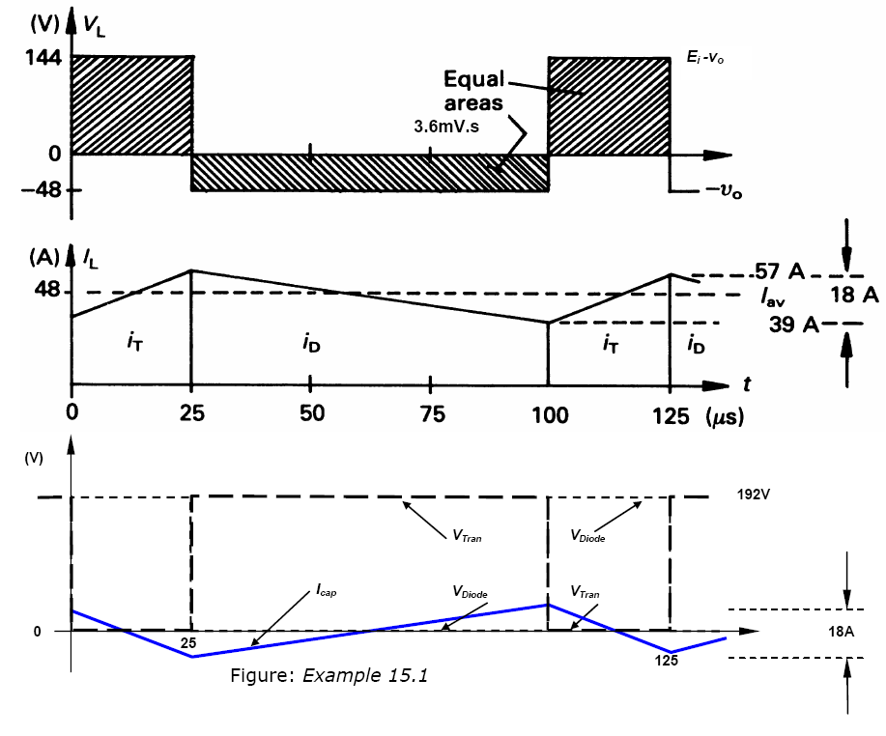
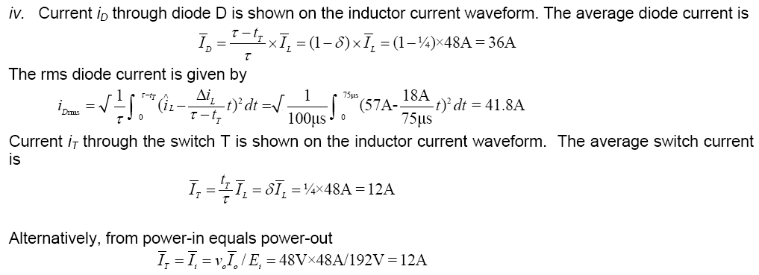
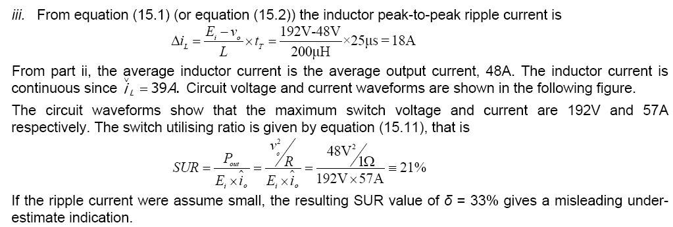
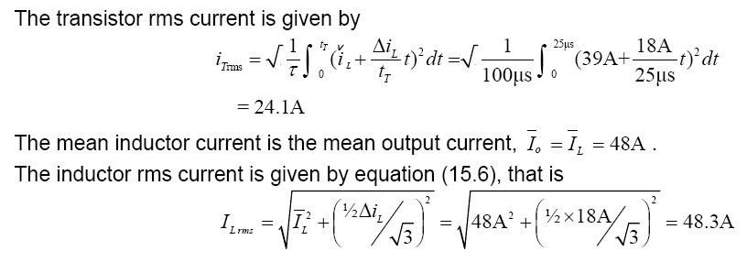
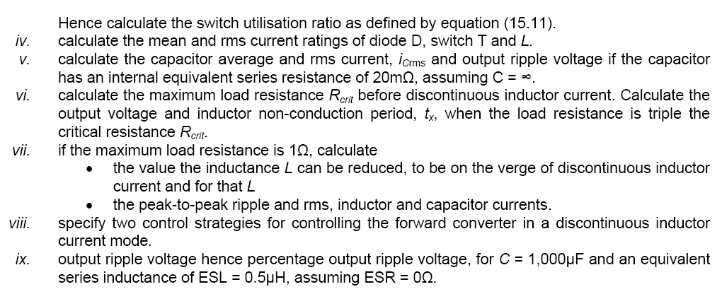

Slide 10
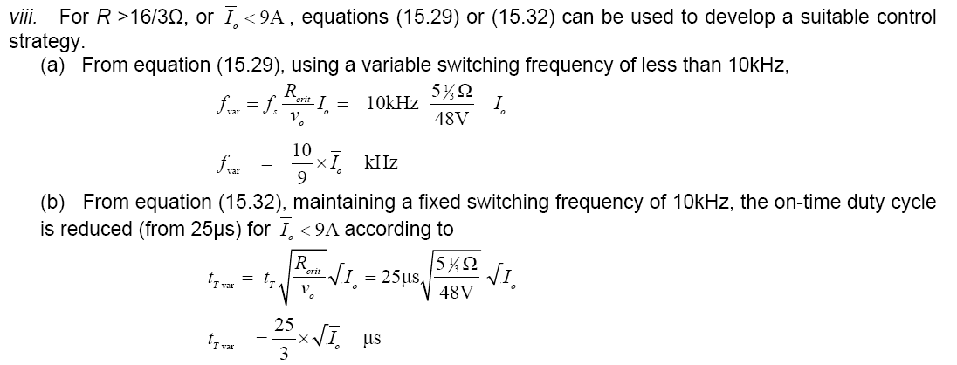
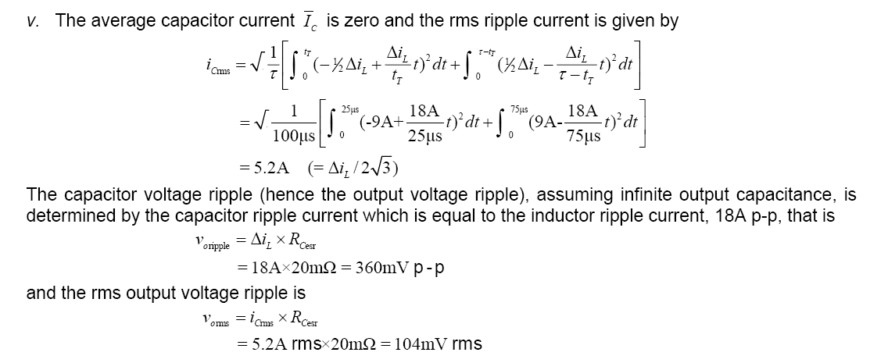
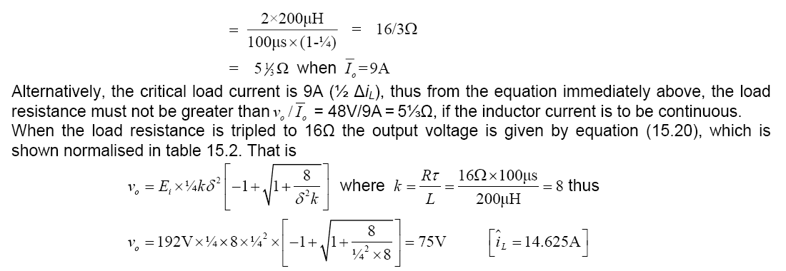
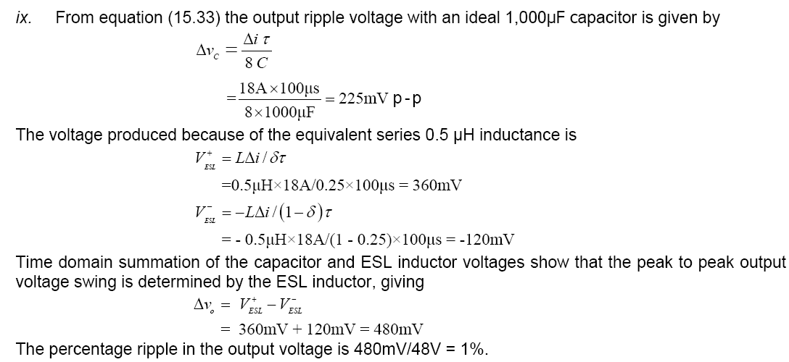
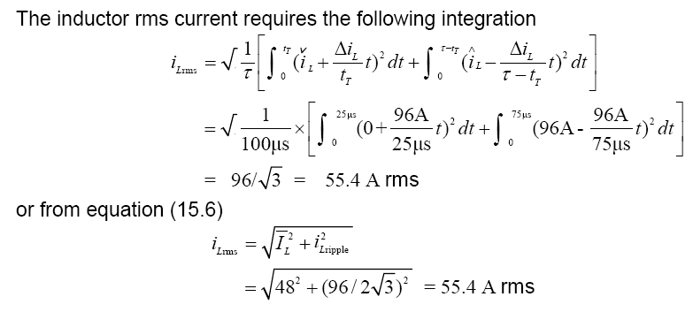

Slide 11
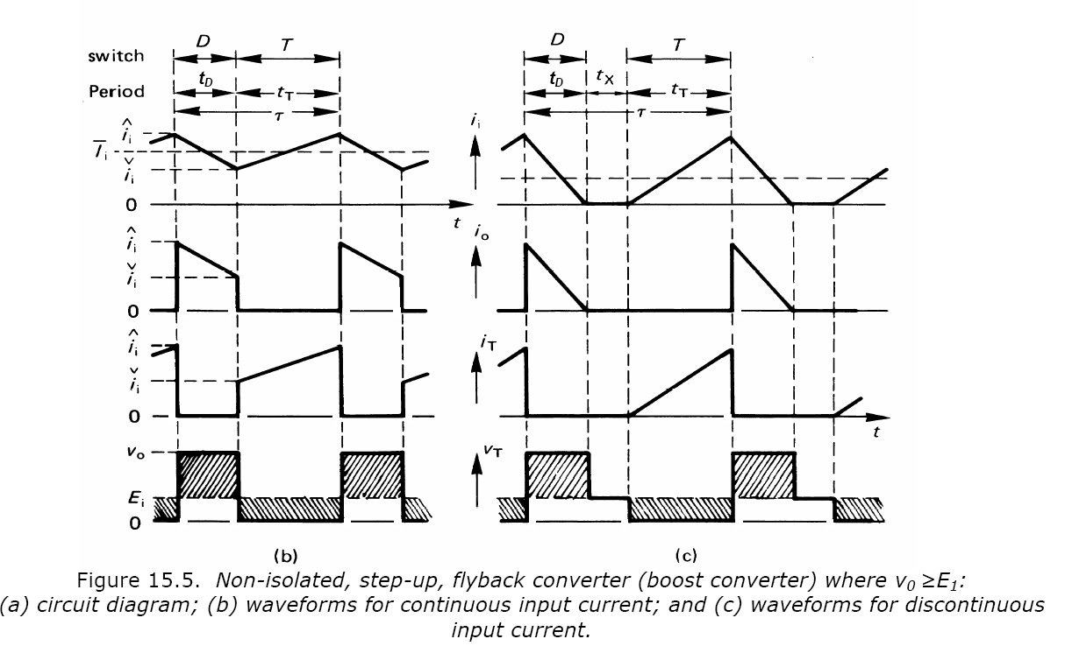

Slide 13
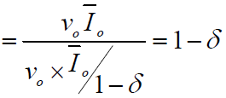

Slide 14
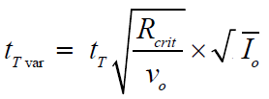
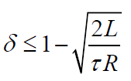

Slide 15
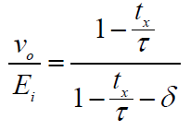
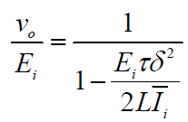

Slide 16
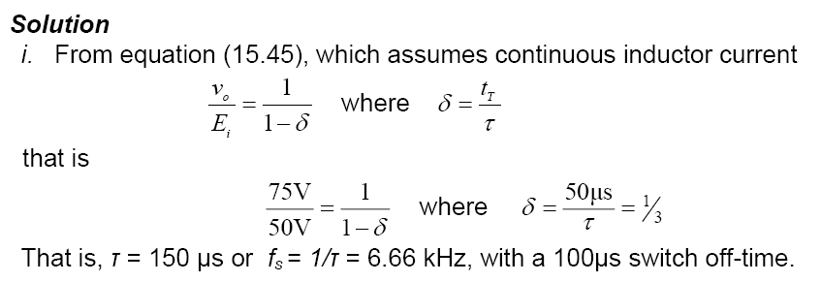
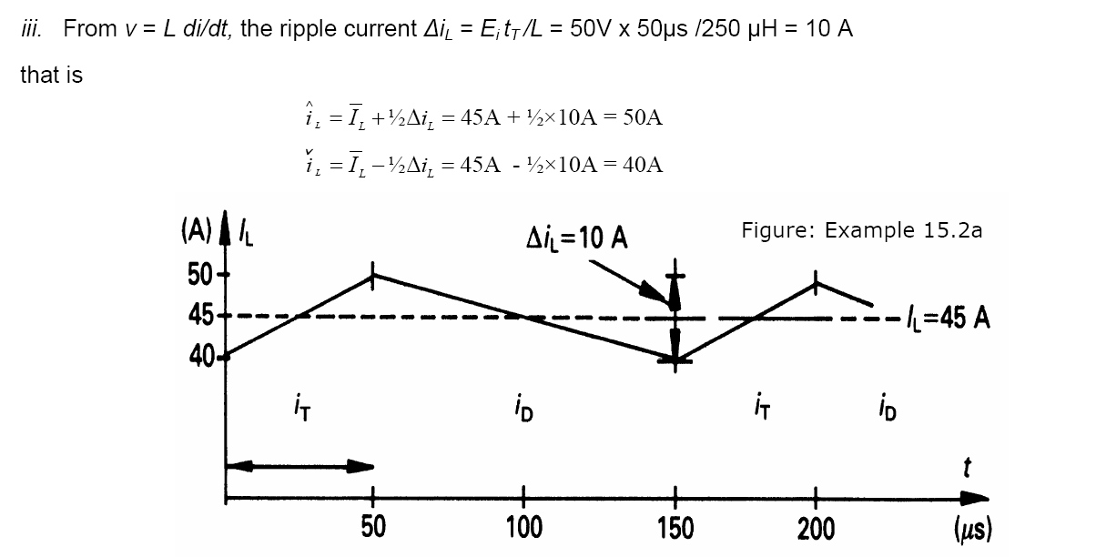
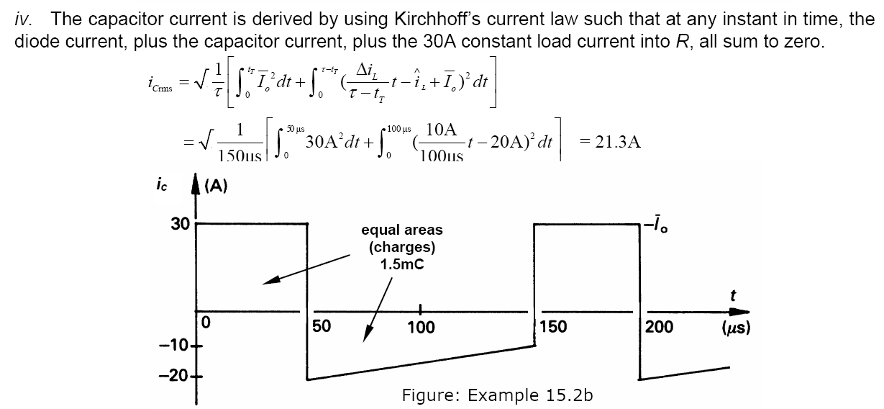

Slide 18
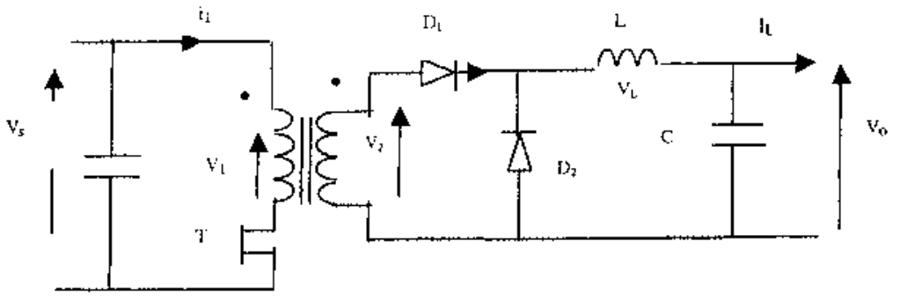
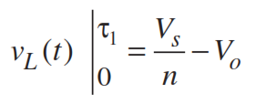
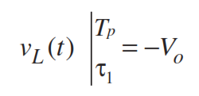
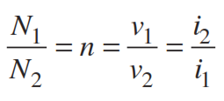

Slide 20
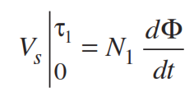

Slide 23
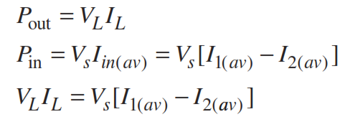
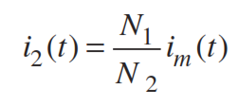

Slide 24
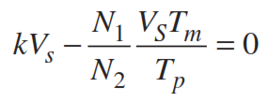
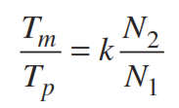

Slide 25
K _{max}

Slide 26
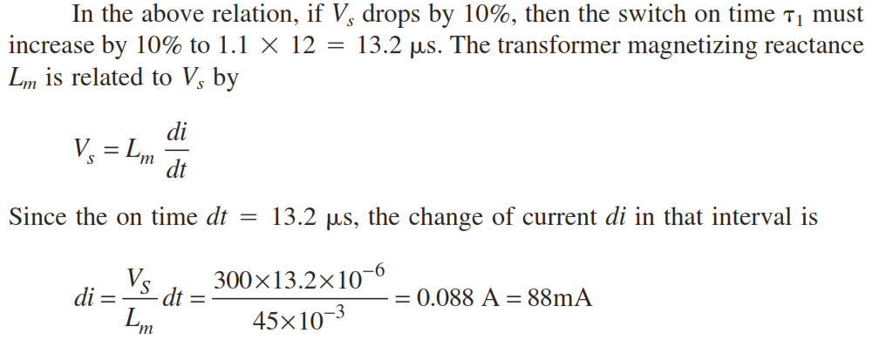

Slide 28
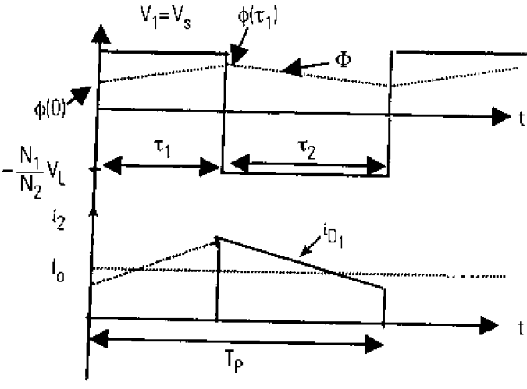
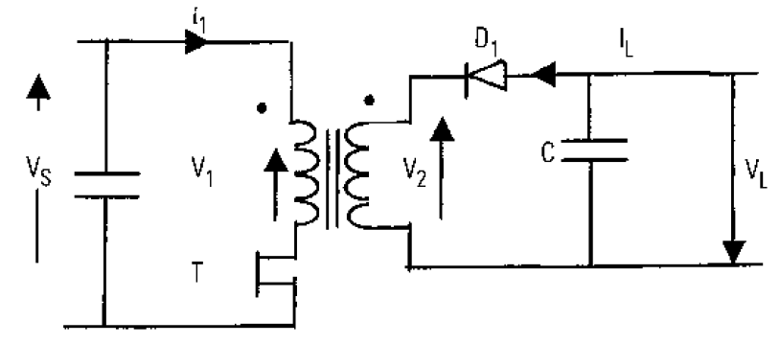

Slide 30
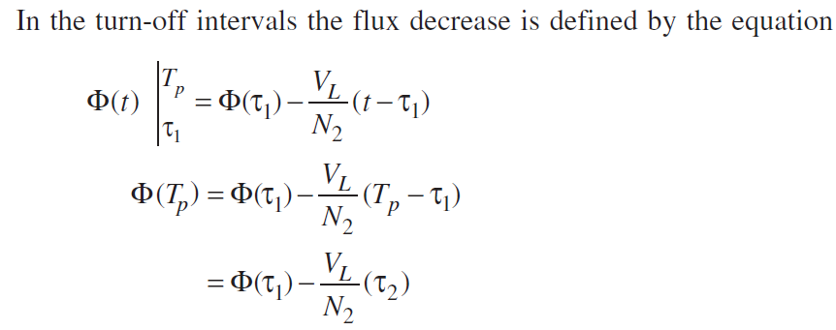

Slide 31
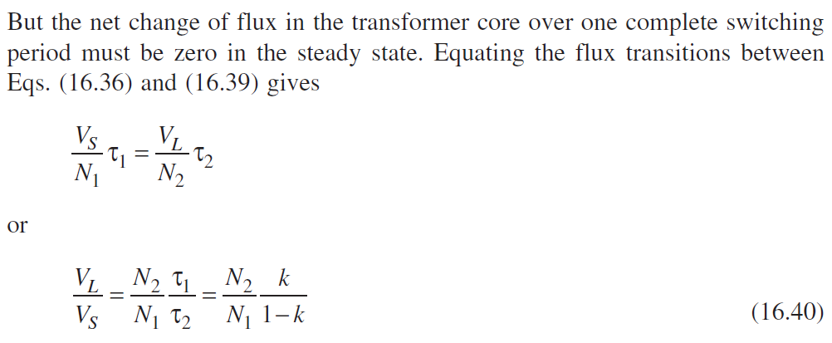
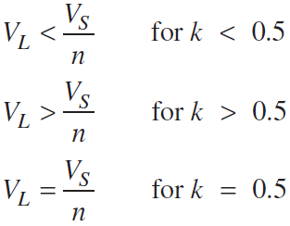

Slide 32
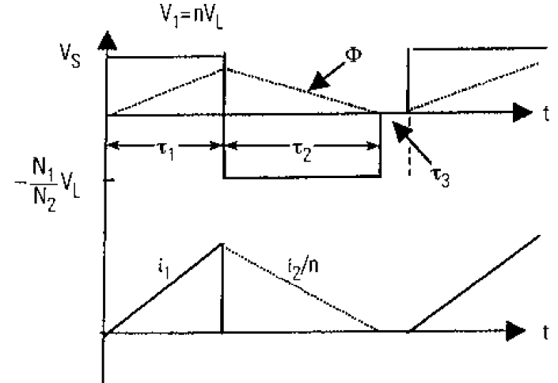

Slide 34
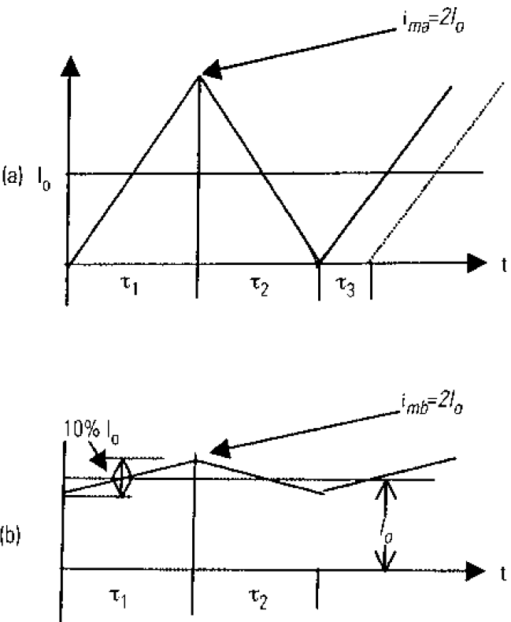
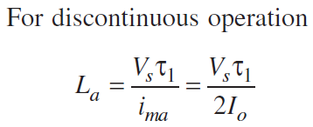
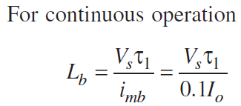

Slide 38
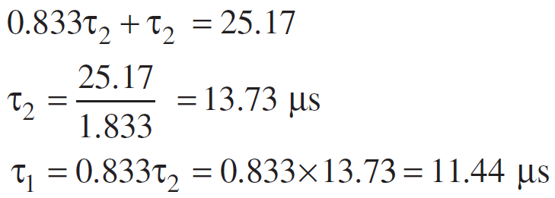

Slide 39
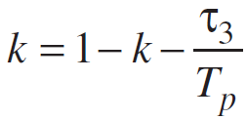

Slide 41
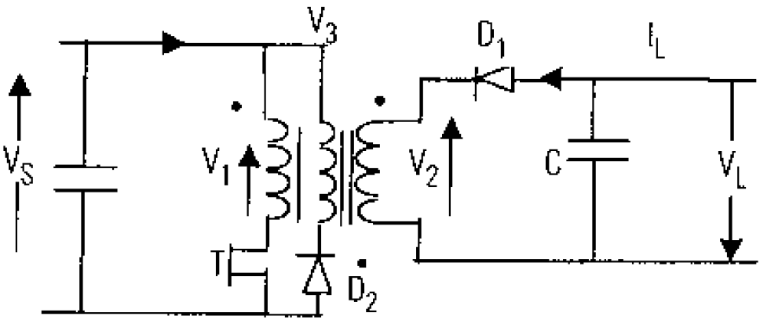

Slide 42
Inverter Applications
Motor Drives
Power back-up systems
Others:
Example HVDC Transmission systems

Slide 43
Voltage Control of Single-Phase Inverters
Commonly-used Techniques
Single-Pulse-Width-Modulation
Multiple-Pulse-Width-Modulation
Sinusoidal-Pulse-Width-Modulation
Modified-Sinusoidal-Pulse-Width-Modulation
Phase-Displacement Control

Slide 44
Single Phase Inverter
Square-wave “Modulation” (1)
V_{dc}
v_{out}(t)
t
-V_{dc}

Slide 45
Single Phase Inverter
Square-wave “Modulation” (2)
THD = 0.48
Characteristics: - High harmonic content.
- Low switching frequency.
- Difficult filtering.
- Little control flexibility.

Slide 46
Single Phase Inverter
Square-wave “Modulation” (3)
V_{dc}
v_{out}(t)
t
-V_{dc}

Slide 47
Single Phase Inverter
Square-wave “Modulation” (4)
THD = 0.3
Example with V_{out-1}=1.21V_{dc}
Characteristics: - High harmonic content.
- Low switching frequency.
- Difficult filtering.
- More control flexibility.

Slide 48
Single Phase Inverter
Pulse Width Modulation (1)
D is the duty cycle of switch Q₁. D is the portion of
the switching cycle during which Q₁ will remain
closed.
In PWM D is made a function of time
D=D(t)

Slide 49
Single Phase Inverter
Pulse Width Modulation (2)
Let’s
Modulation
function
where
Modulation
index
Fundamental
Signal

Slide 50
Single Phase Inverter
Pulse Width Modulation (3)
Moving average
t

Slide 51
Single-Pulse-Width-Modulation

Slide 52
One Pulse per Half-Cycle Pulse Width Controls the Output Voltage

Slide 53
Carrier and Reference Signals
Gate Pulse
Gate Pulse
Compare the Reference Signal with the Carrier
Frequency of the Reference Signal determines the frequency of the Output Voltage
Modulation Index = M = A_{r}/A_{c}

Slide 54
rms value of the Output Voltage

Slide 55
Fourier Series for the Output Voltage

Slide 56
Times and angles of the intersections
Pulse width d (or pulse angle δ)
T_{S} = T/2

Slide 57
Harmonic Profile

Slide 58
Multiple-Pulse-Width-Modulation

Slide 59
Multiple Pulses per Half-Cycle of Output Voltage

Slide 60
Gate Signal Generation
Compare the Reference Signal with the Carrier
Frequency of the Reference Signal determines the Output Voltage Frequency
Frequency of the Carrier determines the number of pulses per half-cycle
Modulation Index controls the Output Voltage

Slide 61
Gate Signals and Output Voltage
Number of pulses per half cycle = p = f_{c}/2f_{o} = m_{f} /2 where m_{f} = frequency modulation ratio

Slide 62
rms Value of the Output Voltage

Slide 63
Fourier Series of the Output Voltage

Slide 64
The times and angles of the intersections
The pulse width d (or pulse angle δ)
T_{S} = T/2p

Slide 65
Harmonic Profile

